Slide 1
Bullet Drop Slide Presentation
Group 2F
Ulaş İş
Alperen Erkek
Ömer Faruk Ergün
Abdullah Seçkin Özdil

Slide 2
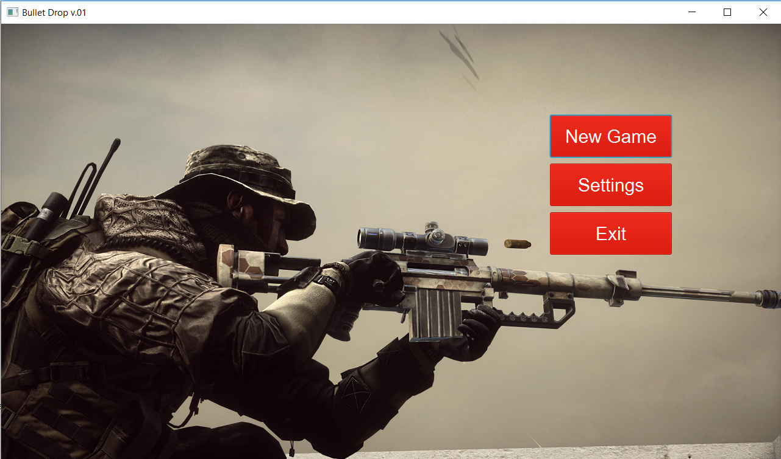
MENU

Slide 3
This is the beginnig of our game, which means when user open the game, this screen appears immediately.
In menu, player sees three different options.
New Game, Settings and Exit.

Slide 4

SETTINGS

Slide 5
In settings part, player can change volume of game sound or he/she can learn how to play.
Then user can go back to main menu.

Slide 6
Weapon Selection
This part appears after player click “New Game” button.
User has five weapon options.
Their abilities are different. User can choose them by looking their powers

Slide 7
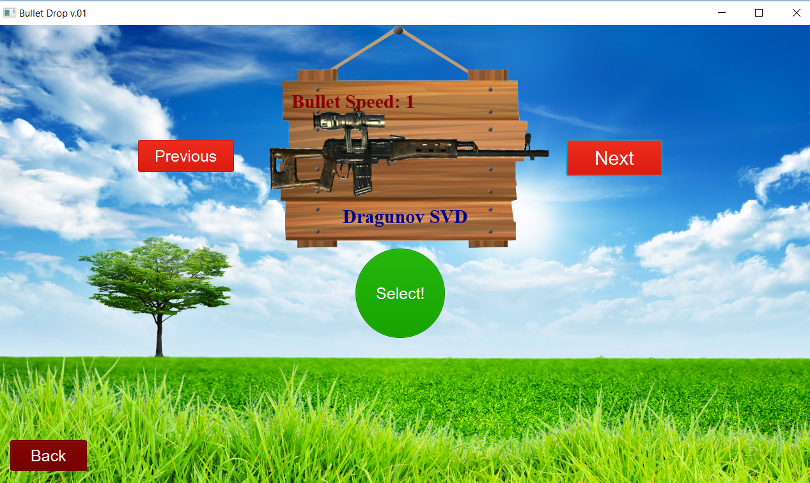
1.

Slide 8
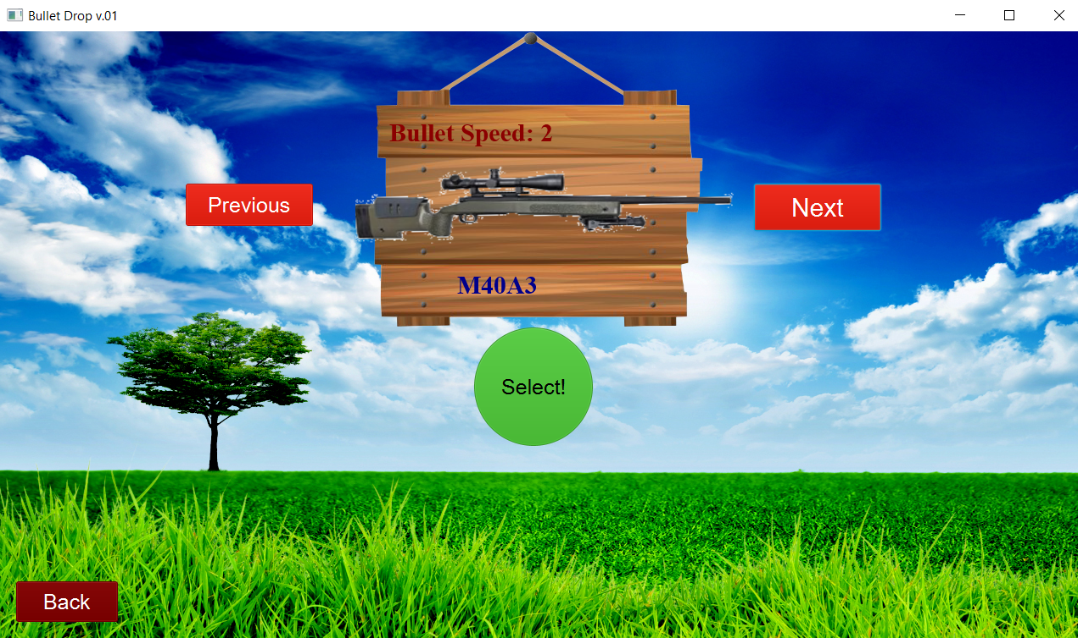
2.

Slide 9
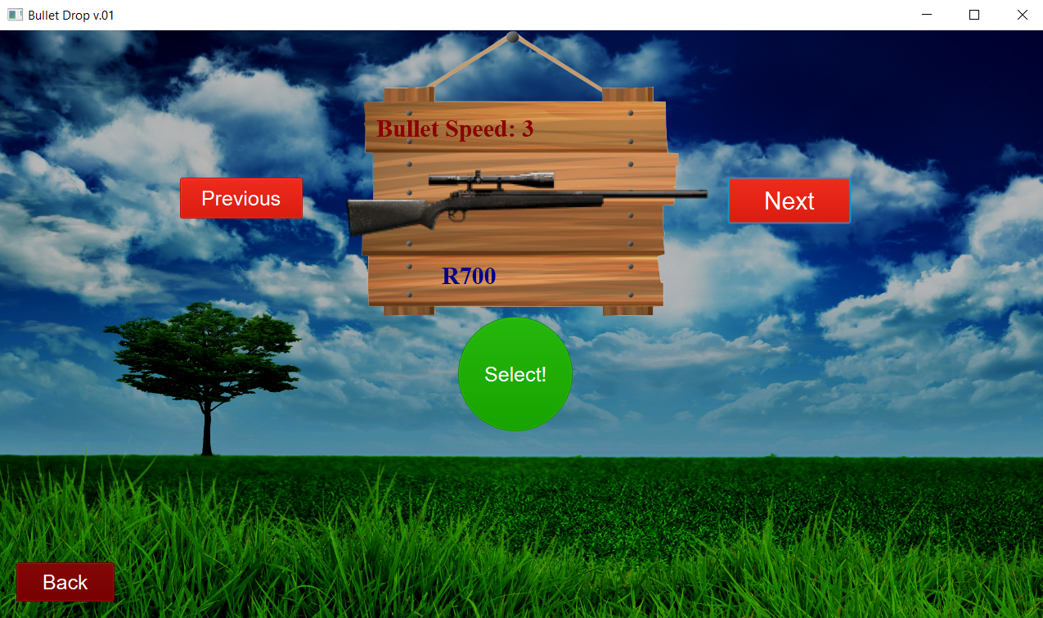
3.

Slide 10
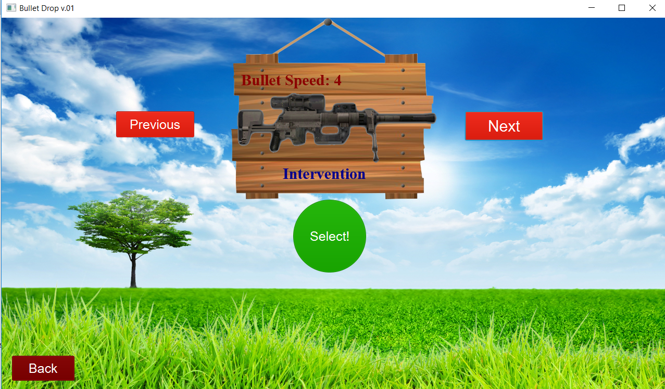
4.

Slide 11

5.

Slide 12
In Game
After weapon selection, game starts.
In this part user can manage weapon’s place by using arrows which are placed top and buttom of the screen.
Then he/she can click the fire button to see where target is.
After this process, user can choose the best place to shot the target.

Slide 13
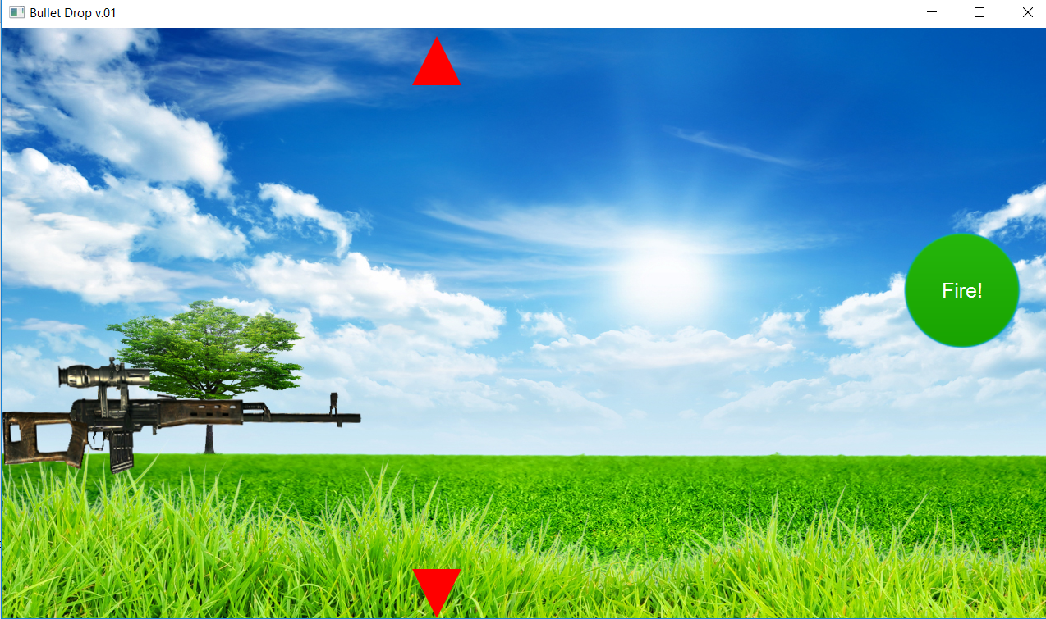
1.

Slide 14
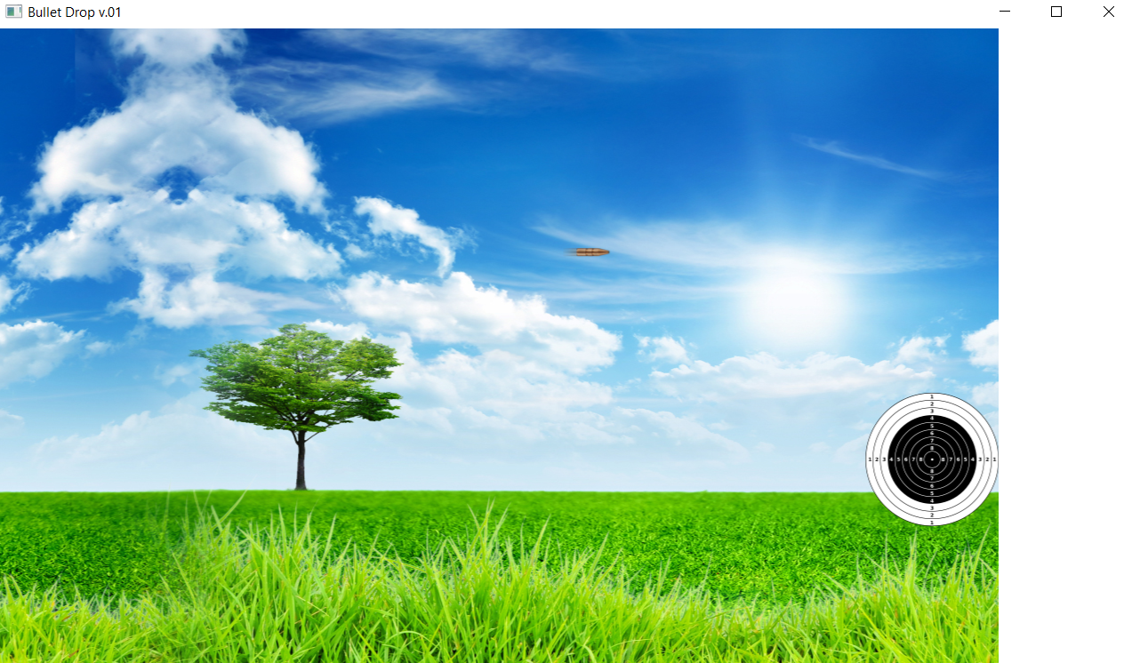
2.

Slide 15
End of The Game
At the end of the game, there is two scenarios for player.
If player miss the target first image will appear.
If he/she success, second image will appear.
If player success, he/she can go the next map of the game by using “Next” button.

Slide 16
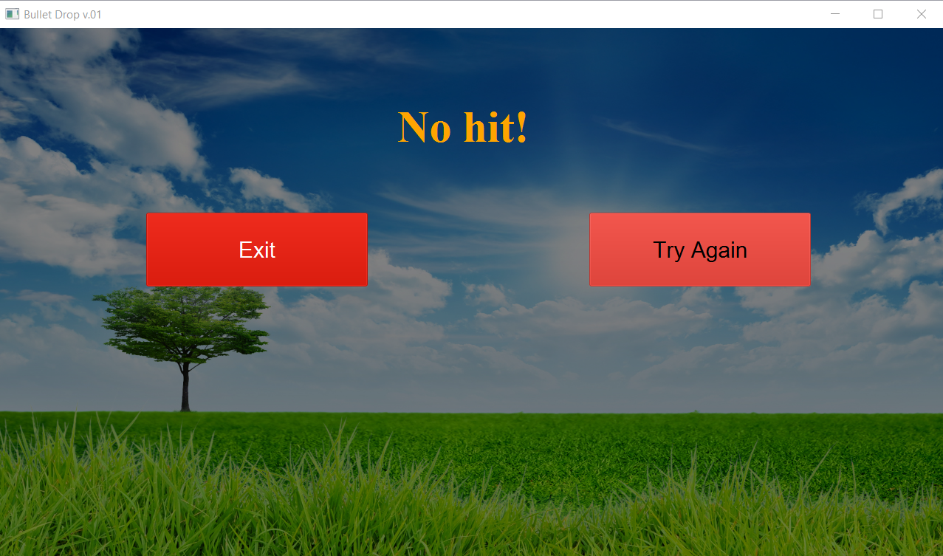
1.

Slide 17
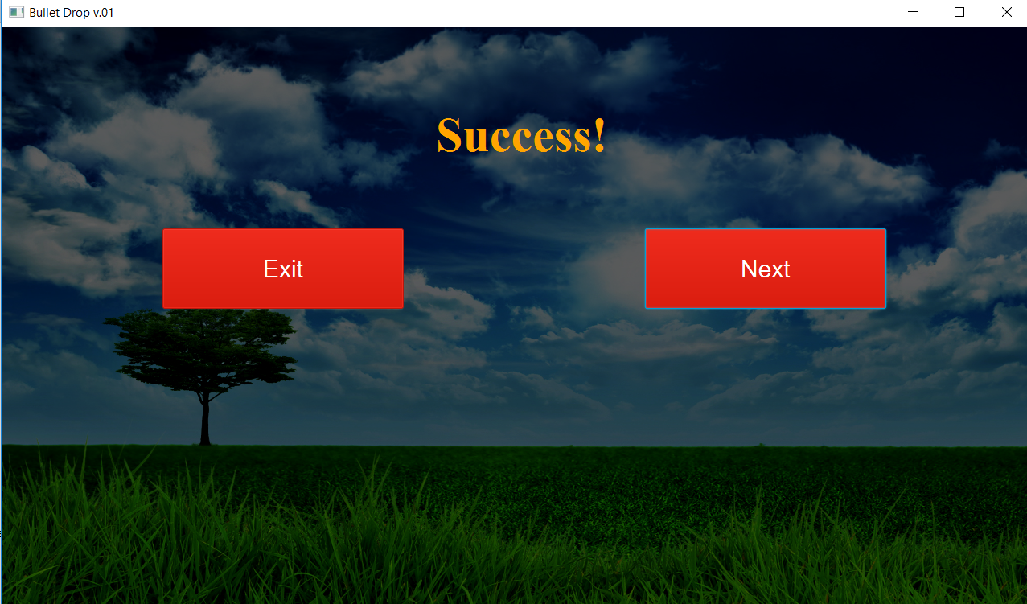
2.

Slide 18
In Complated Parts
The difficulty, counts of the forces, speed of the bullets, effects of the forces will be optimized for best user experience. Also how to play and credits screen will be added to game to make it more informative about game itself and developers. Since our first goal is to create a playable game and fulfill the functional requirements, we prioritized what we implemented over these parts.
Additionally, in order to have more options in terms of ways to play the game, we’ll be adding interaction with keyboard as well.
Finally, there’ll be some graphical upgrades as well as additional sound effects.

